Slide 1
Fault imaging using reflected ground roll
Craig Hyslop
Robert Stewart

Slide 2
Outline
Finding faults and anomalies
Challenge of lateral heterogeneity
Using ground-roll back-reflections
3D and velocity updates
Summary

Slide 3
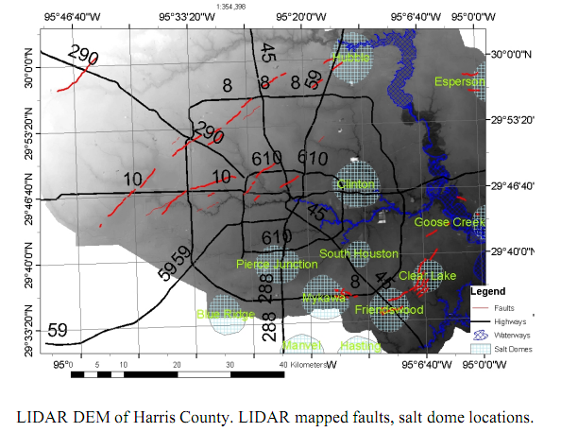
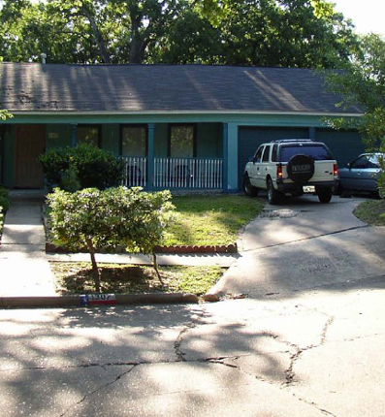
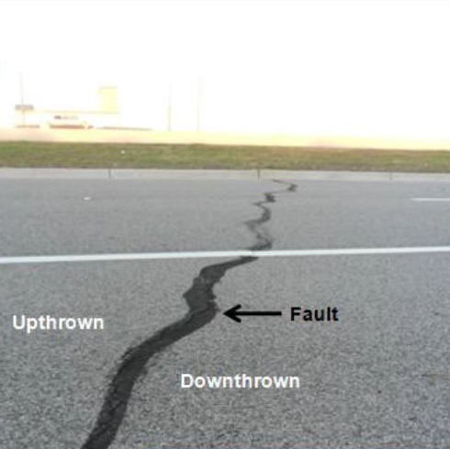
Purpose
Long Point Fault
Hockley Fault
(Engelkemeir, 2006)
(Engelkemeir, 2006)
Notes:
Houston’s geology developed from stream deposits left by the erosion of the Rocky Mountains. These sediments consist of unconsolidated clays, clay shales, and poorly-cemented sands extending to depths of several miles. These deposits were layered on top of decaying organic matter that, over time, became oil and natural gas. Beneath all of this is a water-deposited layer of rock salt. As the layers were compressed and forced upward, the salt dragged surrounding sediments into dome shapes, usually trapping oil and gas that seeped in from any surrounding porous sands. Most of the area’s faults are related to the movement of these salt domes.
Some blame this movement on ground water, oil, or gas withdrawal, but the Long Point Fault is present on topographical maps from the 1910s, prior to major fluid removal, so most geologists believe that the motion is not caused by humans. In fact, there is some evidence that these faults were moving in prehistoric times.
Generally, faults in this area run parallel to the coast and result from the slow slump of the land towards the Gulf. These faults move only very gradually in what is termed “fault creep.” The thick layers of clay sediment do not build up friction, which would produce the ground shaking in an earthquake, so Houston is tremor-free. This is fortunate, since there are 86 mapped and historically active surface faults with an aggregate length of 149 miles!
http://www.geocaching.com/seek/cache_details.aspx?guid=1dbd026f-114a-4b36-ae54-34c8757a2ae9
http://www.washingtonpost.com/blogs/blogpost/post/major-drug-tunnel-to-tijuana-discovered-at-california-border/2011/11/30/gIQAEhQrCO_blog.html
The tunnel, which is 2,200 feet long, the equivalent of more than seven football fields, was found in San Diego’s Otay Mesa area, and leads to a warehouse in Tijuana, according to authorities. The warehouse is on the same block as a federal police office. Marijuana was discovered in the new tunnel and Mack said federal agents would announce the amount, along with other details about the tunnel, at a press conference in San Diego at 5 p.m. ET. 2011
http://www.flickr.com/photos/smsnews/3430159670/in/set-72157616597994876/
A broken underground irrigation pipe cracked and leaked water, causing one lane of the road to collapse, making the route unsafe. The collapse was on East Rd just east of the intersection with Stockton Rd. The road is expected to be closed for several days at least. No injuries reported
2009

Slide 4
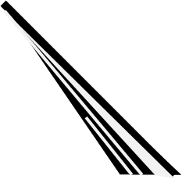
Ground-roll analysis
Collect data
Process dispersion curves VR(f,x)
Invert for VS(z,x)
x
x
v
x
t
f
z

Slide 5
Using back-reflected waves
x
z
Dispersion curves
VR(f,x)
x
z
Back-reflections

Slide 6
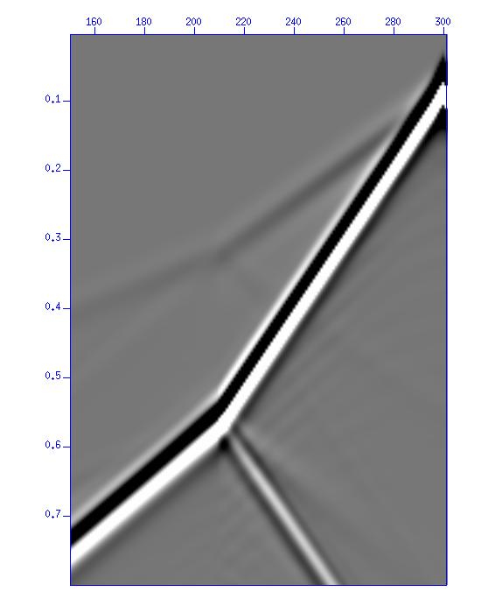
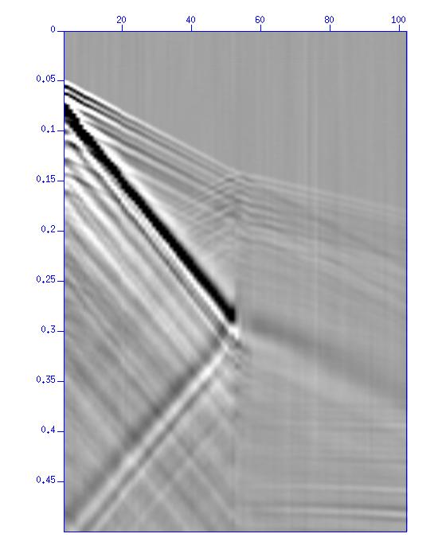
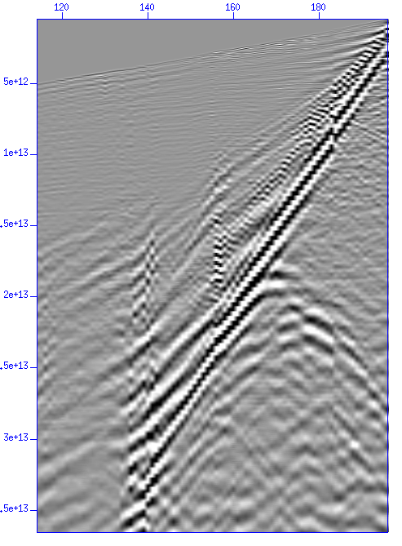
Ground-roll back reflections
Offset (m)
Offset (m)
Offset (m)
0
120
80
40
0
80
40
0
0
1000
500
0
0
.4
.1
.2
.8
.2
1.2
Time (s)
Time (s)
.4
Time (s)
1.6
.3
2.0
.6
.4
2.4
.8
.5
2.8
Synthetic
Physical model
Field

Slide 7
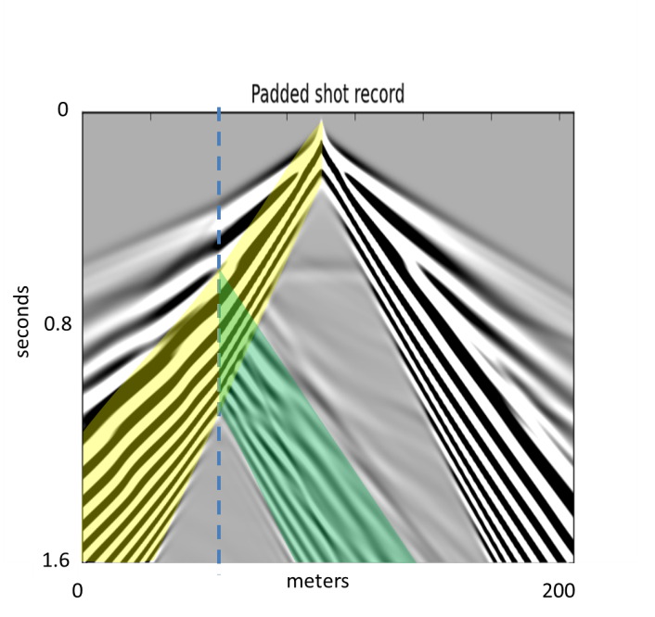
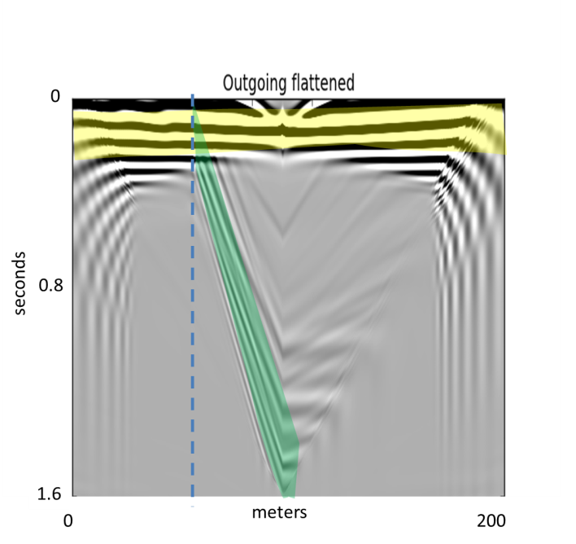
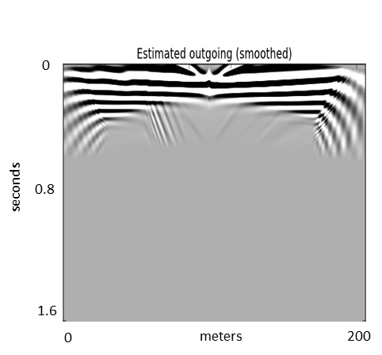
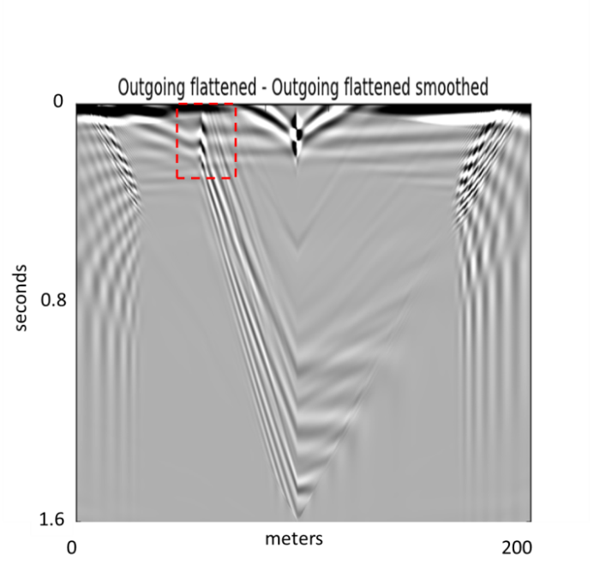
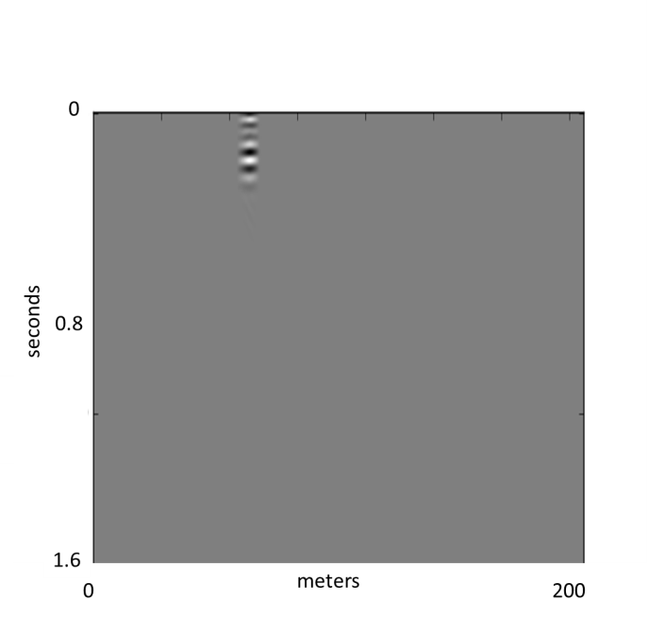
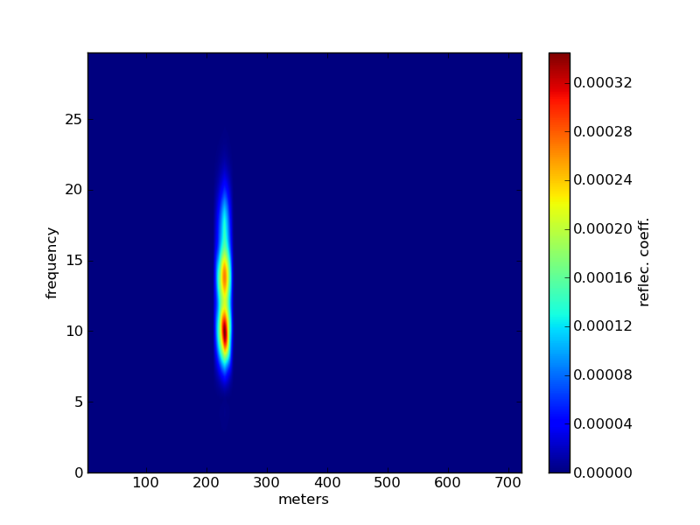
Processing flow
Shot record
Flattened/De-dispersed
Smoothed, outgoing est.
Flattened - outgoing est.
Enhanced/Deconvolved
Spectral reflectivity

Slide 8
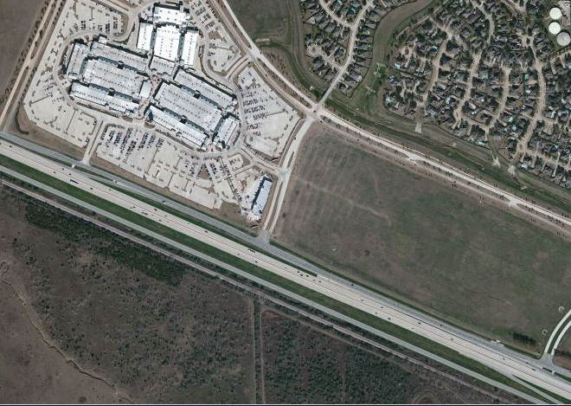
Hockley fault
Premium Outlet Mall
Equipment
216 geophones @5m
  recorded @ 1ms
Sources
Vertical Vib @5m
Cracks on road reported
Hockley fault zone
Imagery Microsoft – available exclusively through DigitalGlobe

Slide 9
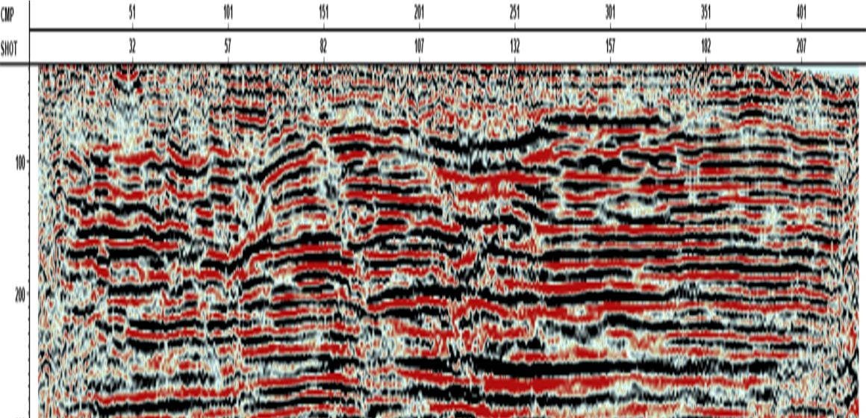
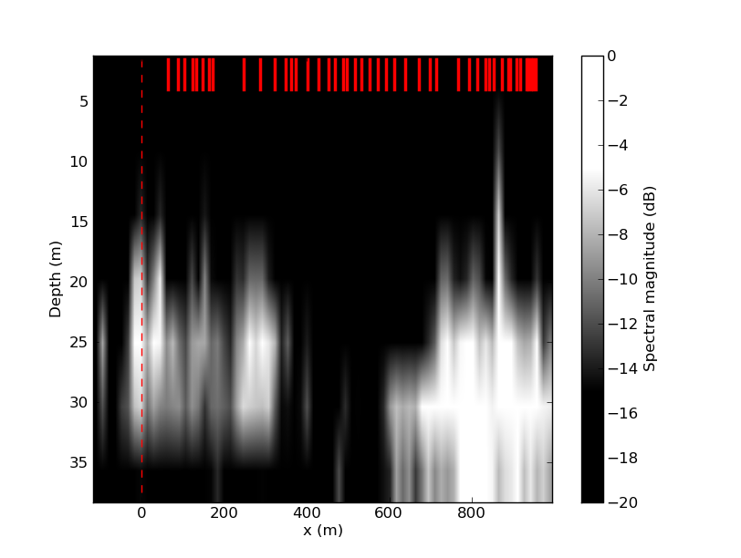
Hockley fault: image
(m)
(m)
0
0
200
400
600
800
1000
0
30
(m)
60
90

Slide 10
Hockley fault: image
(m)
(m)
0
0
200
400
600
800
1000
0
30
(m)
60
90

Slide 11
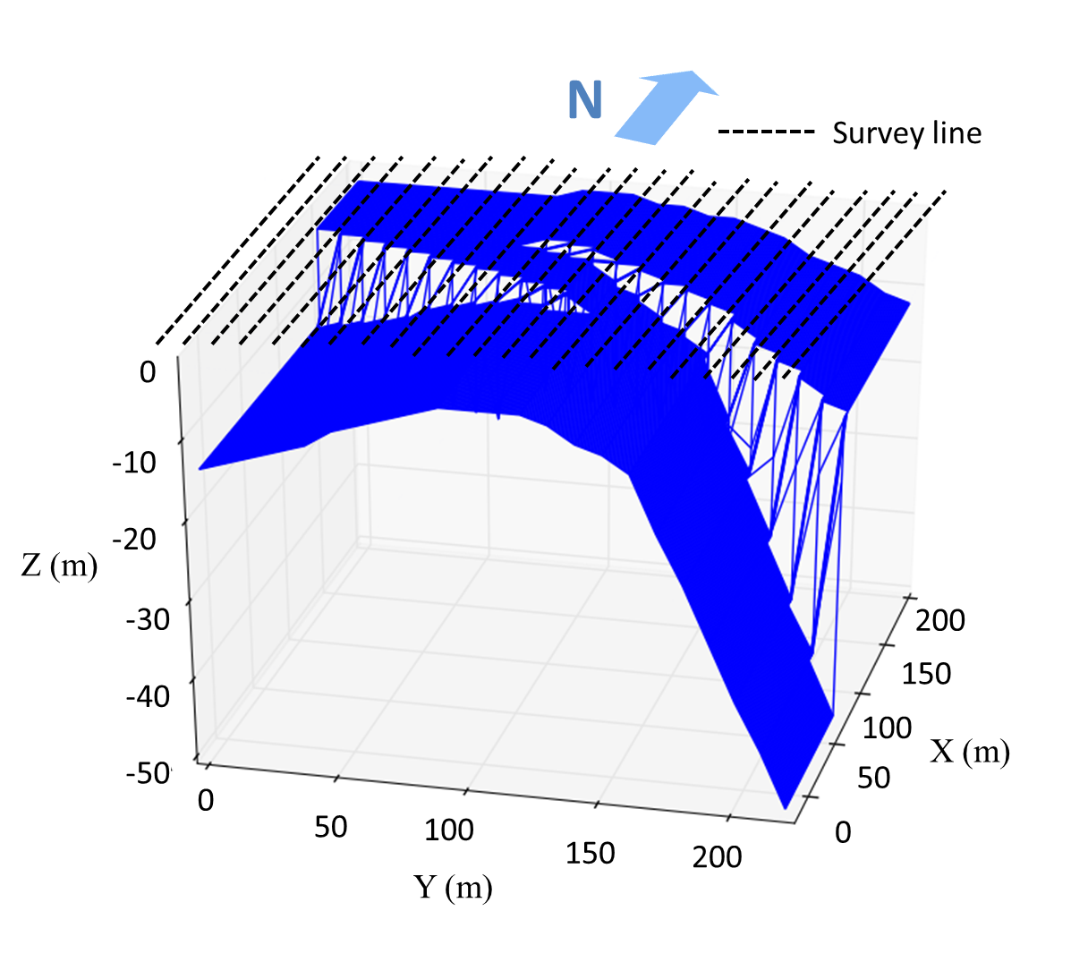
3D survey
Synthetic model
(SPECFEM3D)
23 lines:
each line:
220 receivers @ 1m
22 sources @ 10m
fd = 15Hz

Slide 12
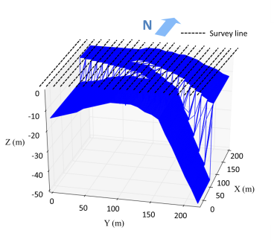
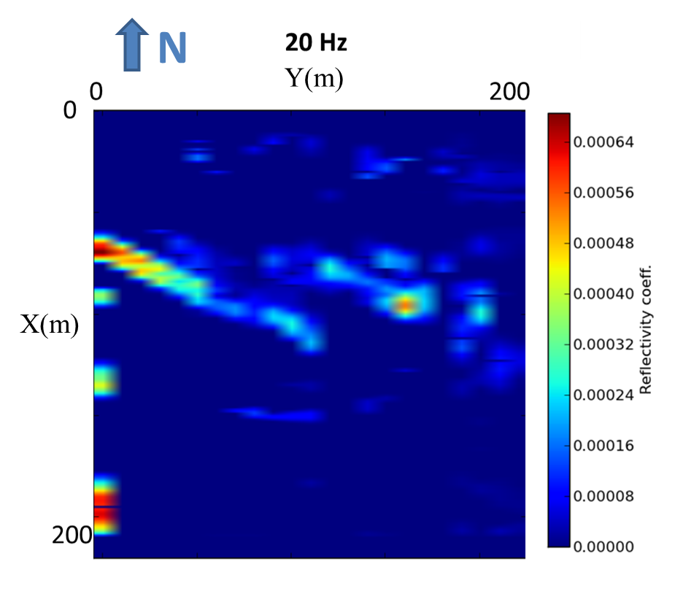
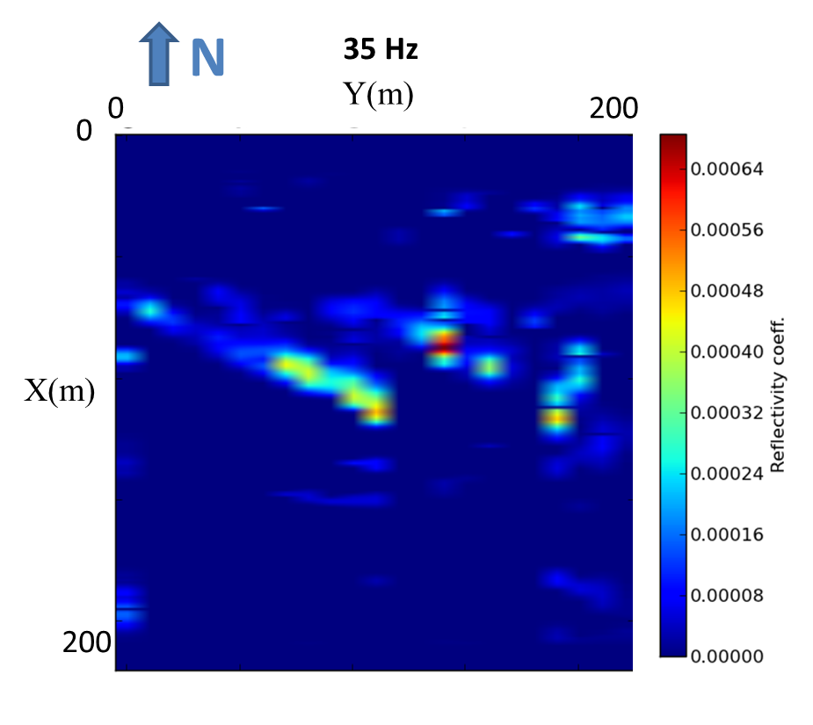
3D survey
35 Hz
f
20Hz
x
y

Slide 13





Updating the velocity model
Update phase velocities
$$u_{i}$$
$$u_{i+1}$$
$$f_{j}$$
$$u_{i+1}=αu_{i}$$
where,
$$α=\frac{R_{u_{i}}+1}{{1−R}_{u_{i}}}$$

Slide 14
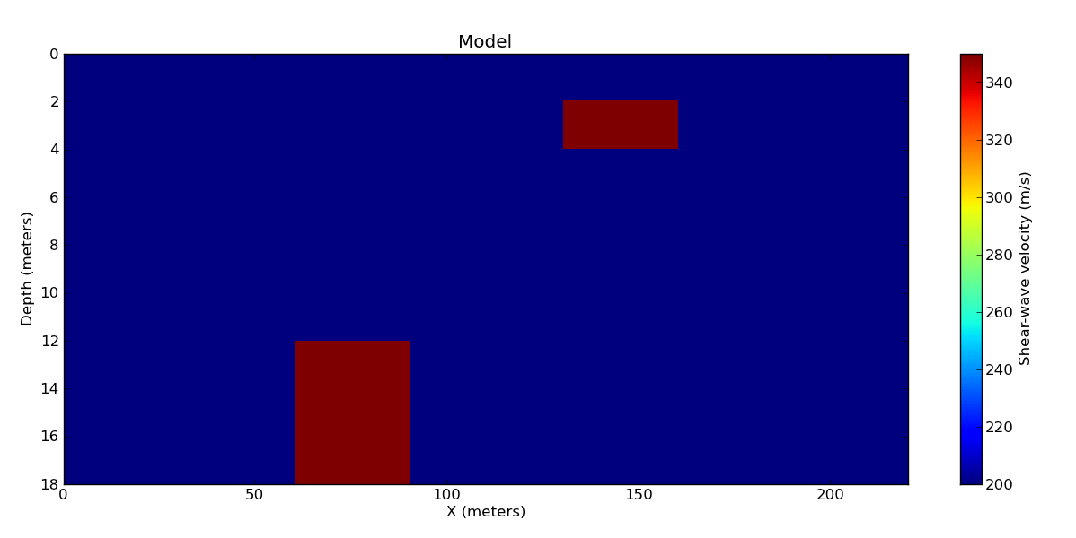
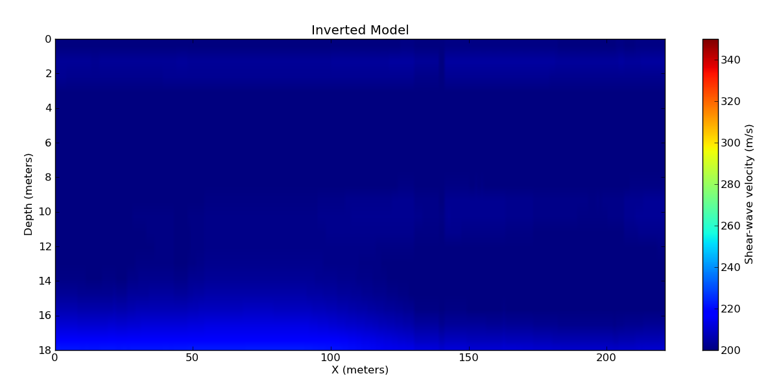
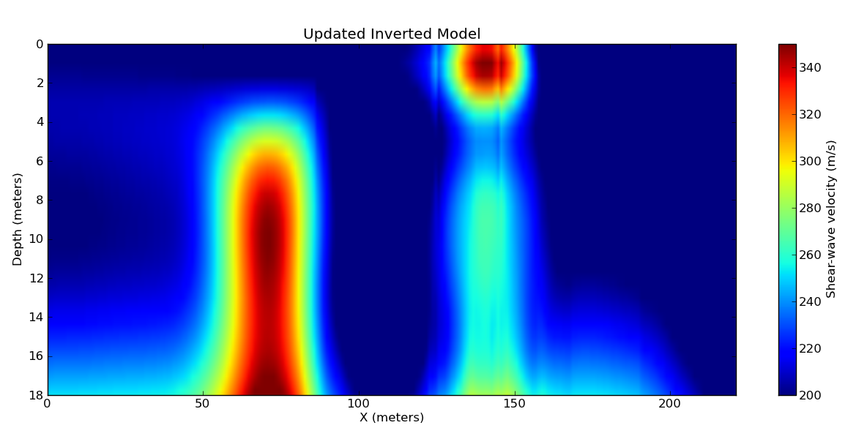
Model
True model
Synthetic model
(SPECFEM2D)
220 receivers @ 1m
22 sources @ 10m
fd = 15Hz
Starting model
Inverted model

Slide 15
Summary
Faults and anomalies can be located using back-reflected surface waves.
Reflectivity can be useful for interpretation.
Velocity model can be updated using reflectivity.

Slide 16
Thank you

Slide 17
Extra

Slide 18
Using reflectivity
F
Dispersion curves
VR(f,x)
MASW
F⁻¹
Model
Data
F⁻¹
F
VS(z,x)
F⁻¹??
D(t,x)
Filter / Decon
F
Reflectivity
RR(f,x)

Slide 19
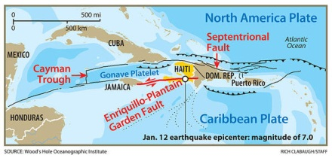
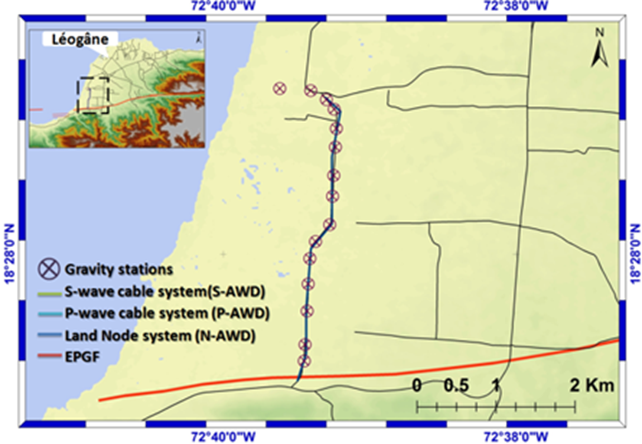
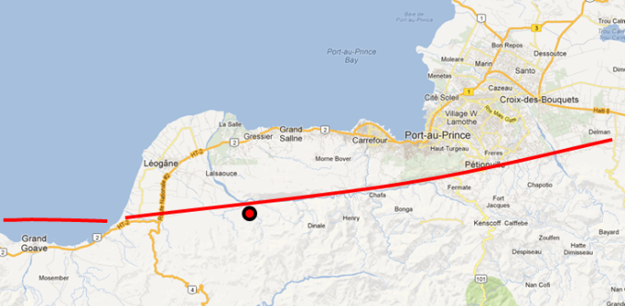
Haiti
Equipment
P-wave cable system
119 geophones @5m
  recorded @ ?ms
Source
Hammer@5m
Survey Area
Jan 12, 2010 epicenter
Notes:
Jan 12 2010 7.2
There is a highly complex tangle of tectonic faults near the intersection of the Caribbean and North American crustal plates.
The Haiti earthquake epicenter is marked by the star along the displaced portion (shown in red) of the Enriquillo-Plantain Garden Fault. The fault lines with small arrows denote a different kind of fault called thrust faults, where one plate dives under another. Strike-slip faults grind past one another. The dotted lines at bottom denote complex seafloor formations. (Source: P. Jansma, and G. Mattioli, Geol. Soc. Amer. Spec. Paper 385, 13, 2005. )
http://www.csmonitor.com/World/Americas/2010/0121/Haiti-earthquake-Why-the-Caribbean-is-a-mini-ring-of-fire

Slide 20
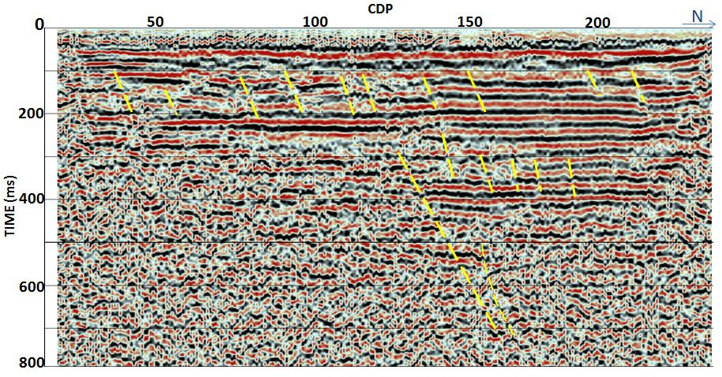
Haiti
(m)
0
100
200
300
400
500
600

Slide 21
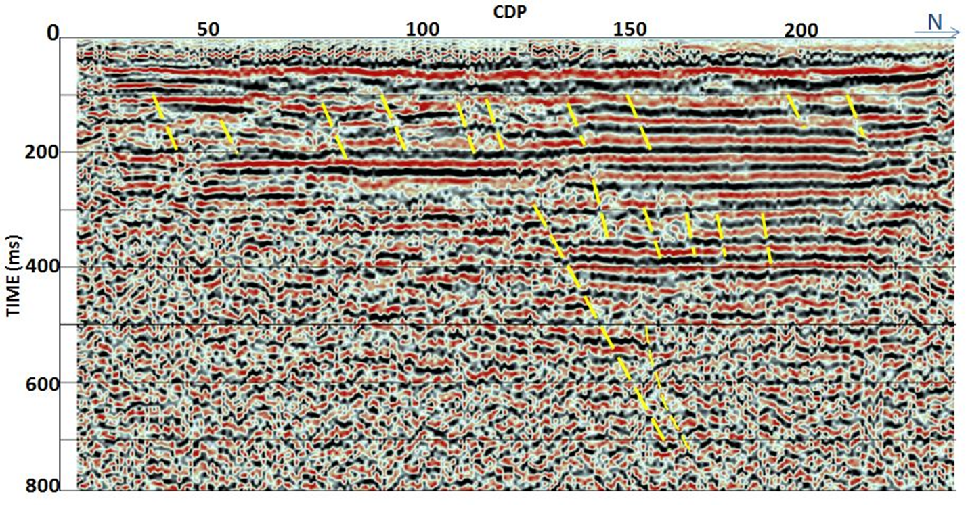
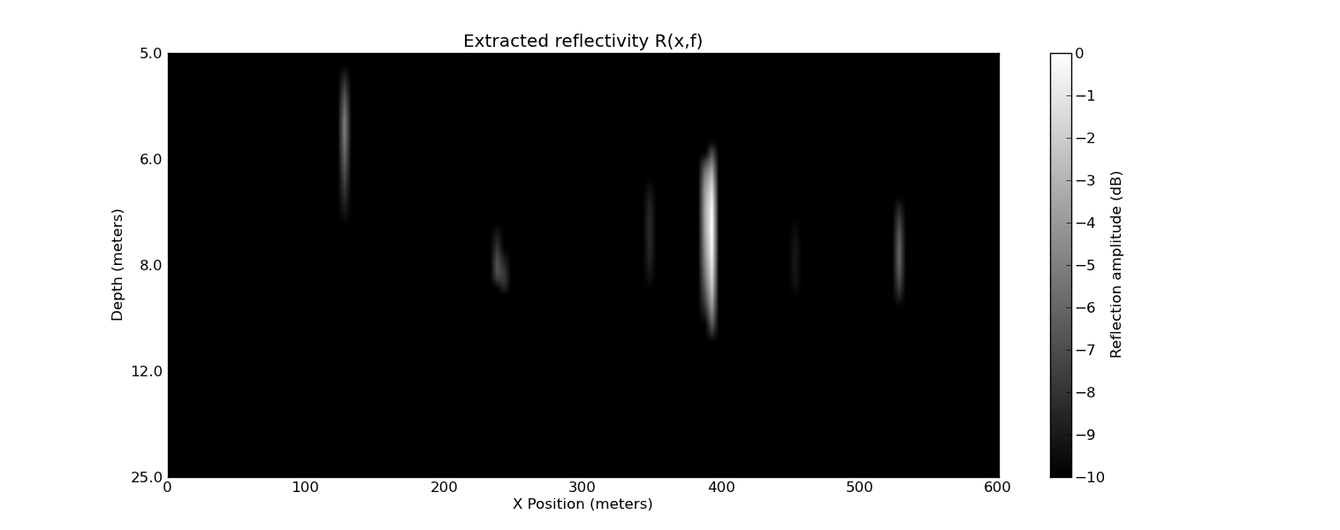
Haiti
(m)
0
100
200
300
400
500
600

Slide 22
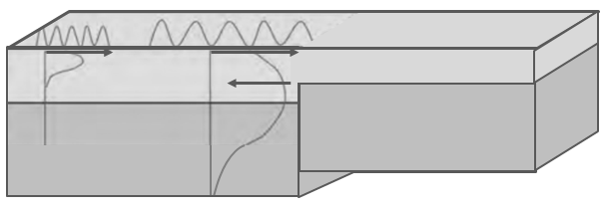

Surface wave reflection
$$R(f)$$

Slide 23
Lateral heterogeneity
Process dispersion curves within “windows” of total lateral extent
Invert at each spatial location
x
z

Slide 24
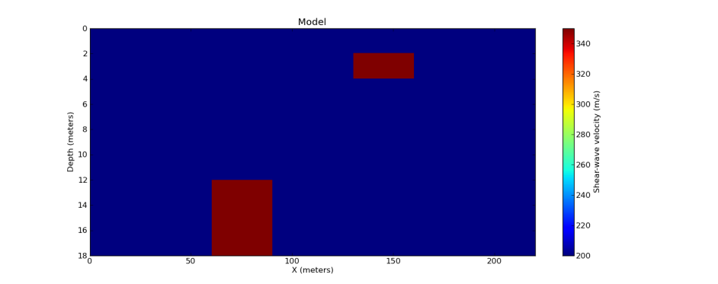
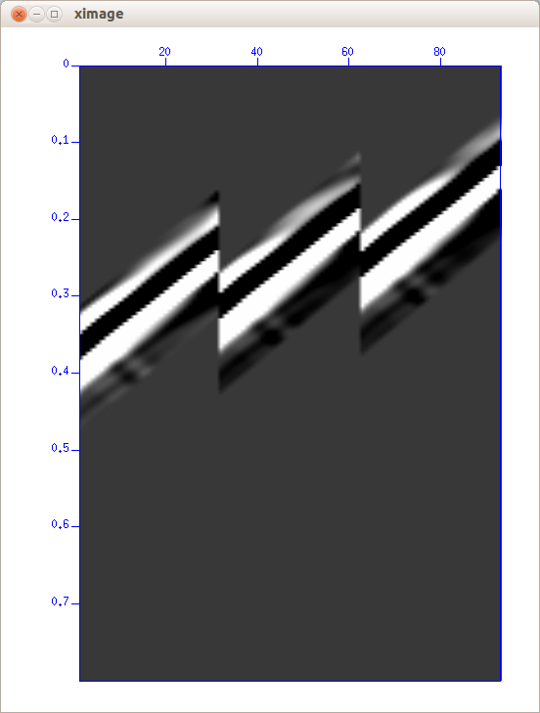
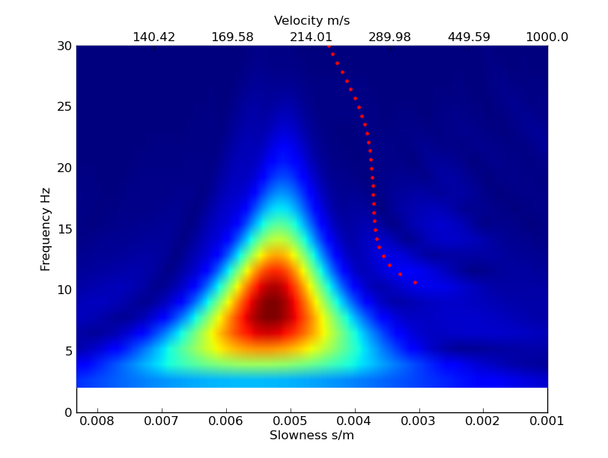
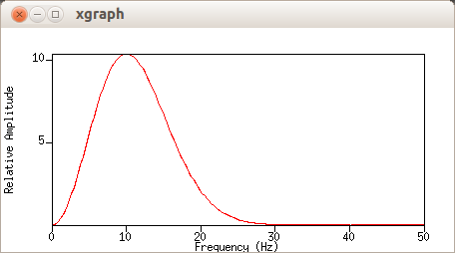


20
10
6.7
$$λ$$
(m) @200 m/s

Slide 25
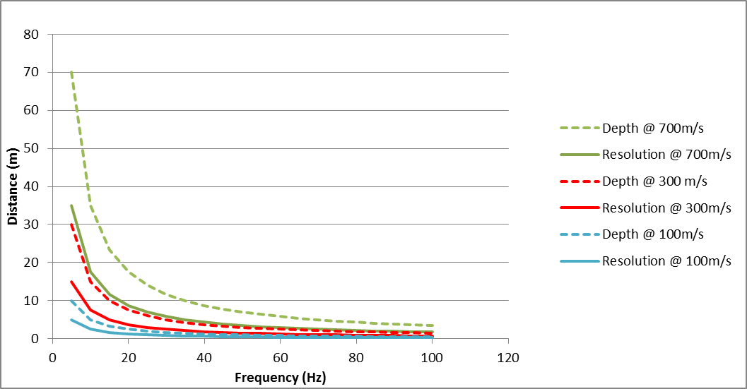

Slide 26
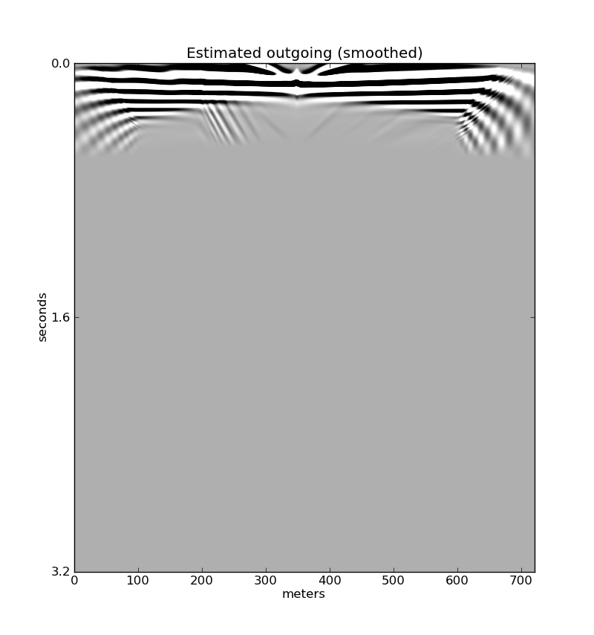
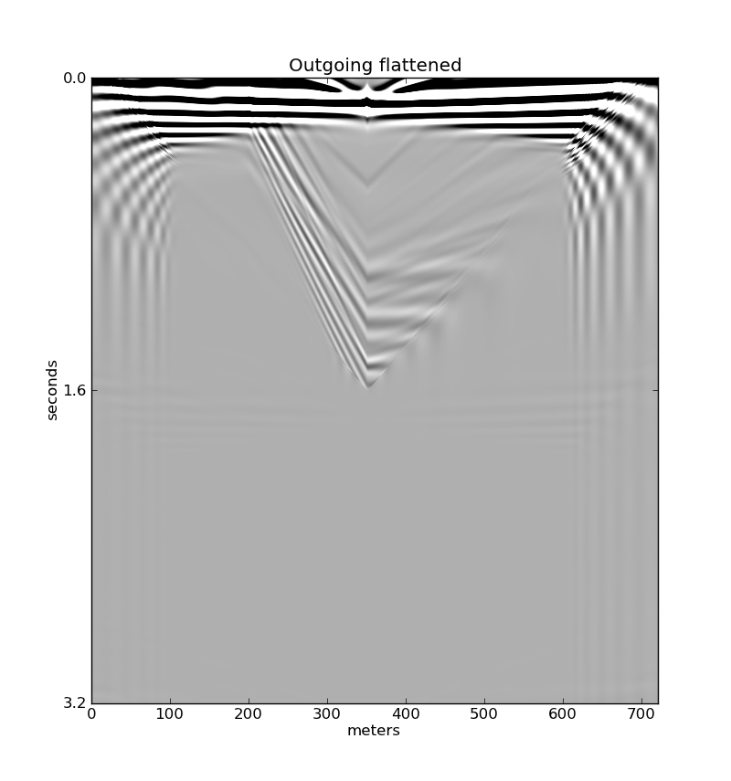
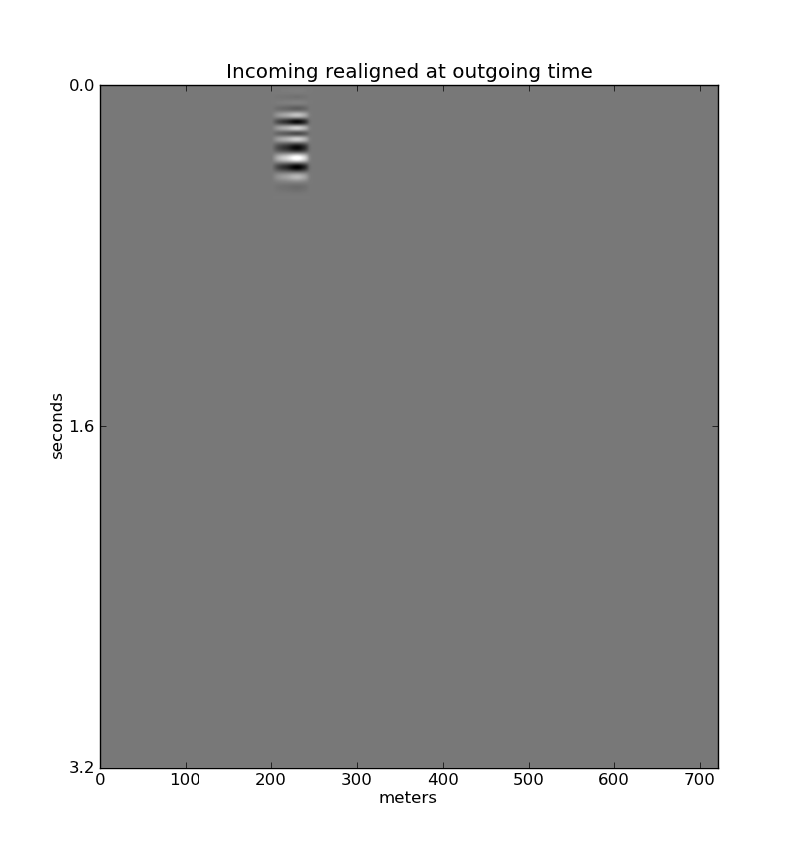
0
seconds
0.8
1.6
0
meters
200

Slide 27
